Slide 1
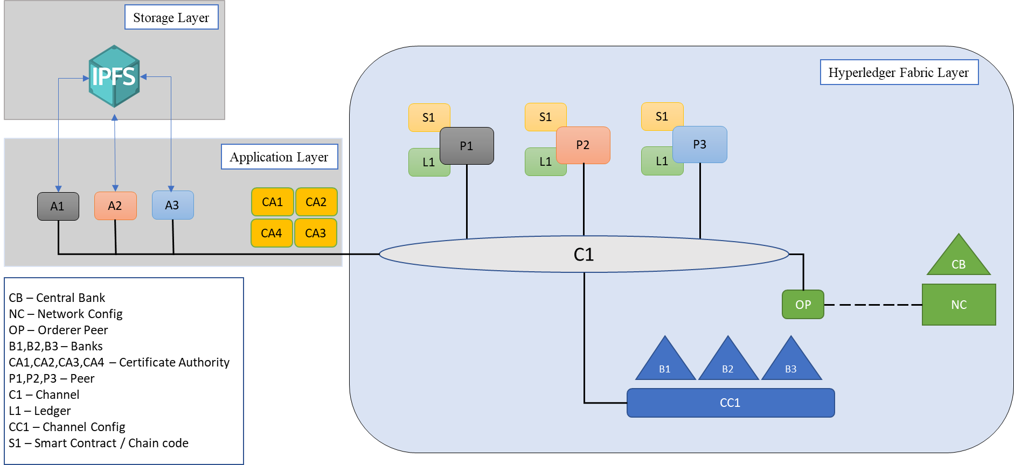

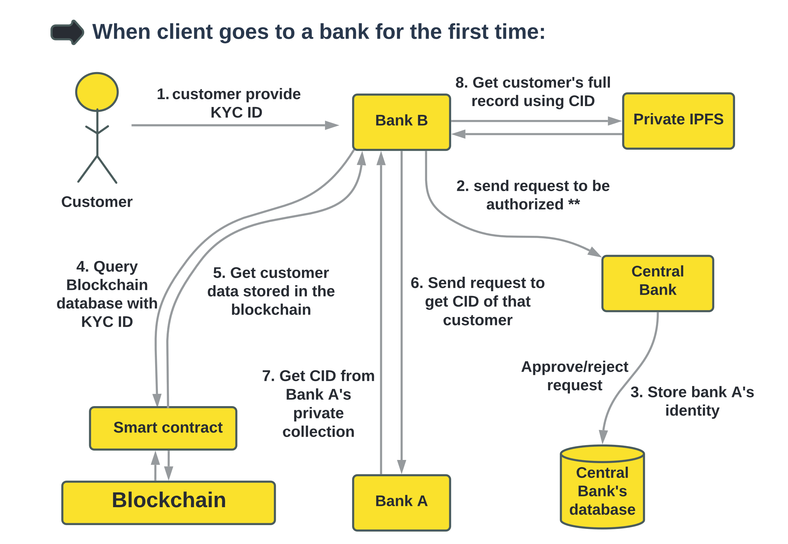
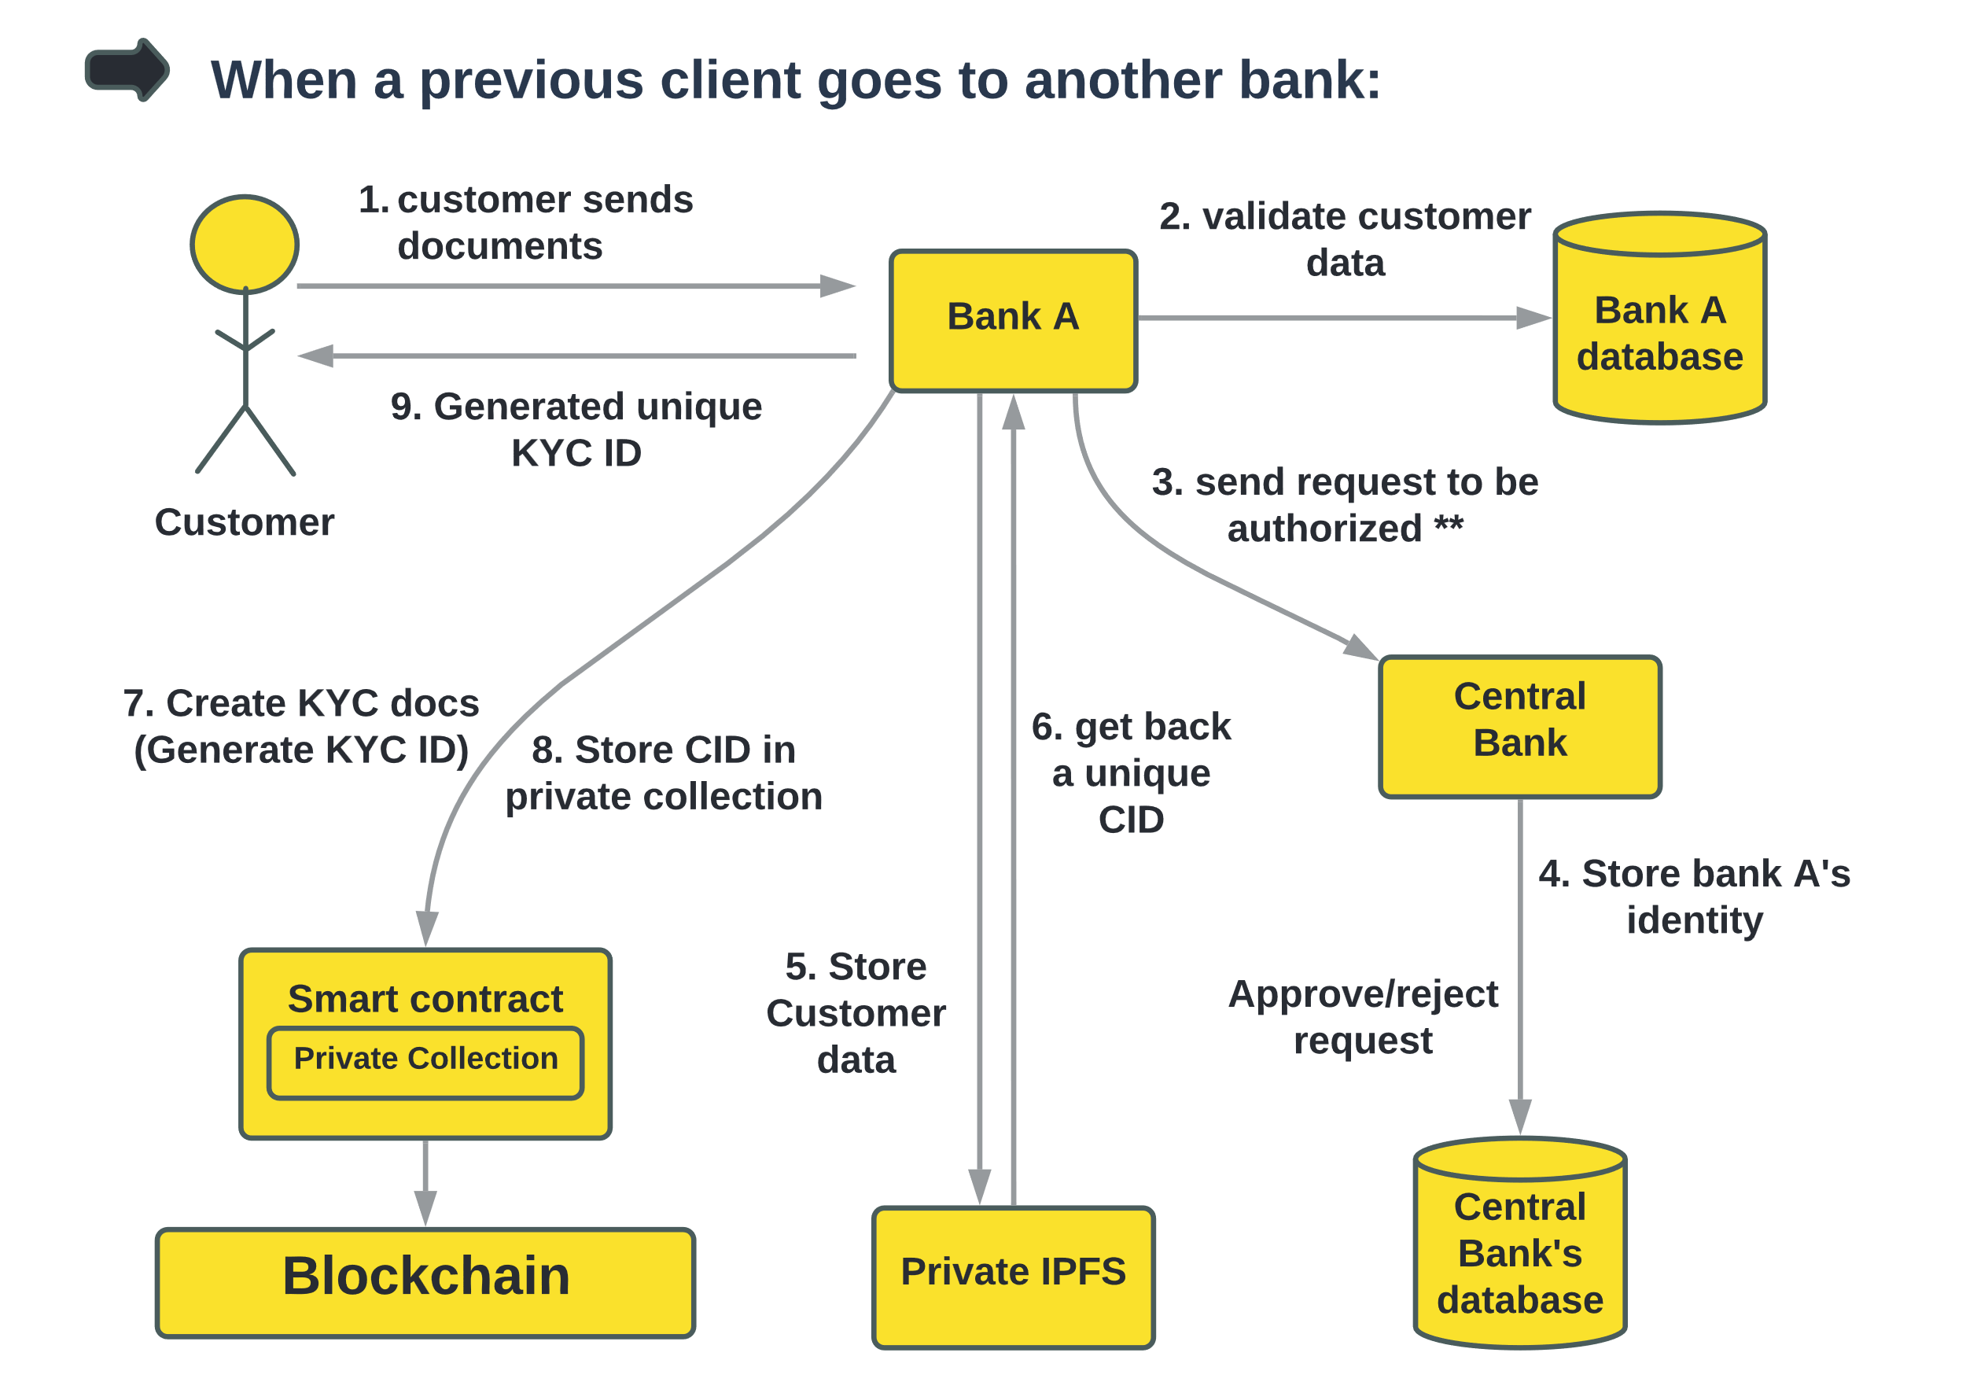
Know your Customer (KYC) Implementation on a Decentralized Architecture with Hyperledger Fabric and IPFS
Team: ForToZero
Abstract
Architecture & Dataflow
Business Model & Value Proposition
The traditional KYC process has many shortcomings. It is a very inefficient and time-consuming process which leads to financial loss both for the client and the organization. If any client wants to open accounts in multiple banks then the sufferings knew no bounds. The problem can easily be solved by the integration of blockchain technology. In the proposed model, integration of Hyperledger Fabric (a private blockchain) and Interplanetary File System (IPFS) will be used to build a decentralized application for Banks to upload files containing KYC details. The proposed model will be designed using the private blockchain for it’s striking features like enhanced privacy and transparency. The trust issue for KYC file storage will have been solved by the Interplanetary File System (IPFS) which is a decentralized platform.
Framework overview:
Business model canvas:
Key
Partners
Central Bank
State-Owned Commercial Banks
Private Commercial Banks
Foreign Commercial Banks
Credit Unions
Wealth management firms and broke-dealers
Private lenders and lending platforms
Key Activities
Register a Client
Verification of KYC Data
Ensuring Integrity of Clients Data
Value
Propositions
Privacy and Security of Data
Increase Transparency
Reduce Time and Cost
Remove Duplication of Process
Immutability
Improve Efficiency
Customer
Relationships
Digital marketing
Offline marketing
Customer feedback
Key Resources
Permissioned Blockchain (Hyperledger Fabric)
IPFS (Interplanetary File System)
React.js, Node.js, Docker
Channels
Online(Web app/Mobile App/ Website)
Offline( Submit all the necessary documents to bank)
The framework is divided into three layers -
Hyperledger Network Layer: This includes Peers, Orderer peer, Channels, and Certificate Authority (CA). The CA is responsible for issuing public and private keys and digital certificates. Administrators and Peers must be authenticated by the CA to become part of the blockchain network.
Application Layer: The partners or the peers are connected to the blockchain network through the application, which uses the SDK to interact with the blockchain network and can access the ledger through Peers using the Chaincode, and the administrator(central bank) needs to register through CA to participate in transactions in the system.
Storage Layer: Peers that join the same channel will also join the channel’s IPFS network, which is a distributed file system for storing and sharing data, and generating a hash address for storing data, which is a key component.
Cost Structure
Design
Development
Quality Assurance
Revenue Streams
Time efficiency
Security
New Job Opportunities
Customer Segments
People of a country who
want to open account in the
banks
Opportunity
Maintenance
Consulting
Problems:
Duplication
Regulation
Redundancy
Security concerns
Costly
Solutions:
Remove duplication
Added security
Increased transparency
Efficient
Reduced cost
Value proposition canvas:
User friendly environment
Data privacy
Time - efficiency
Smooth information flow
Easily open bank account
Open accounts in multiple banks without wasting time
Gain creators
Immutability
Protection from identity theft
🙂
Gains
Data security
KYC verification without any hustle
Secure the private key
Market
📦
Products and services
👨‍💼
Customer jobs
Financial institutions have reported spending $60 million annually, based on research conducted by Consult Hyperion in 2017. Some are spending up to $500 million each year on KYC. Global spend on Anti-Money Laundering (AML)/ Know-Your-Customer (KYC) data & services is projected to total a record $1.35 billion in 2021. As such, there is a huge market for this project to tap-into despite the pre-existing competitors and alternative solutions besides Hyperledger Fabric.
KYC verification
Reduction of repetitive process
Technological challenges during earlier stage
Give all the info correctly
Online based documents transfer
💊
Pain relievers
Reduction of unnecessary hassle
🙁
Pains
Doesn’t have proper devices
Dataflow:
Will save a lot of time and money
Every info will be secured
Cost Distribution
The cost for this initiative can be divided into two sections: the initial cost to set up the system and the maintenance cost to ensure smooth operation.
Initial cost: It includes cost of making the whole blockchain and IPFS storage network and deployment server cost. This cost will be borne by the central bank. Other partners will have to pay a premium to the central bank in order to be added to the private blockchain network.
Maintenance cost: It includes the cost of maintaining the server. Some developers and system admins will be in charge of maintaining it. The central bank will bear a certain percentage and the rest would be divided amongst the other partners. These partners will pay an annual fee according to the amount of resources allocated towards their needs and the number of their clientele in regards to the maintenance cost.
Competitors
e-KYC registration services in the market
Shortcomings:
Data is fetched from a central server
Database recovery measures are very costly
Data security is always an issue
This model is not very trustable
The data is mutable
Central bank can’t monitor the whole system
Team ID: BD 10
References
Members:
Shuvo Ahmed, CUET(ME)
Istiaqur Rahman Fuad, RU(CSE)
Nayemur Rahman, JU(IBA)
Fahim Kabir, BRACU(CSE)
SM Al Meraj, RUET(MTE)
Amesar, Yash & Nerkar, Yash & Mali, Nitesh & Nitnaware, Ashwin & Prashant, Yawalkar. (2020). Decentralized Banking Application using Block chain Technology.
Uddin, Mueen & Memon, M & Memon, Irfana & Halepoto, Imtiaz & Memon, Jamshed & Abdelhaq, Maha & Alsaqour, Raed. (2021). Hyperledger Fabric Blockchain: Secure and Efficient Solution for Electronic Health Records. Computers, Materials and Continua. 68. 2377-2397.10.32604/cmc.2021.015354.
3. Drgon, Matus & Georgiou, Lamprini & Kiayias, Aggelos. (2020). Robust KYC via Distributed Ledger Technology. 10.6084/m9.figshare.13301363.
Global AML/KYC Spending Projected to Total $1.4 Billion in 2021, Rising 26% as Governments Continue to Focus on Fighting Financial Crime - New Burton-Taylor Report
What is KYC and why does it matter? Available: https://plaid.com/resources/banking/what-is-kyc/
Hegadekatti, Kartik & Yatish, Yatish. (2016). Roadmap for a Controlled Block Chain Architecture. SSRN Electronic Journal. 10.2139/ssrn.2822667.

